Slide 1

VIET NAM - FRANCE
WHAT DIFFERENT?

Slide 2
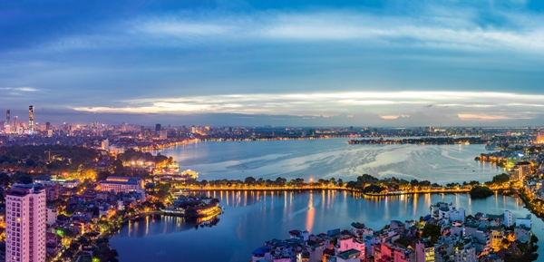

VIETNAM
CAPITAL
FRANCE
HaNoi Capital
Paris Capital

Slide 3
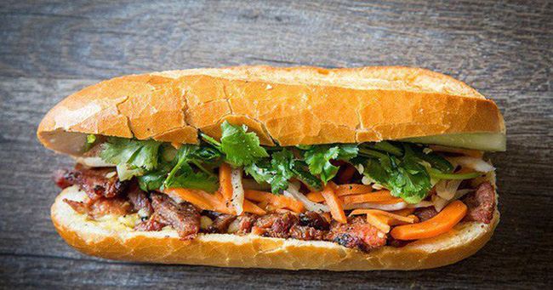



FOOD
VIETNAM
FRANCE
Cheese
Bánh mì
Phở
Wine

Slide 4
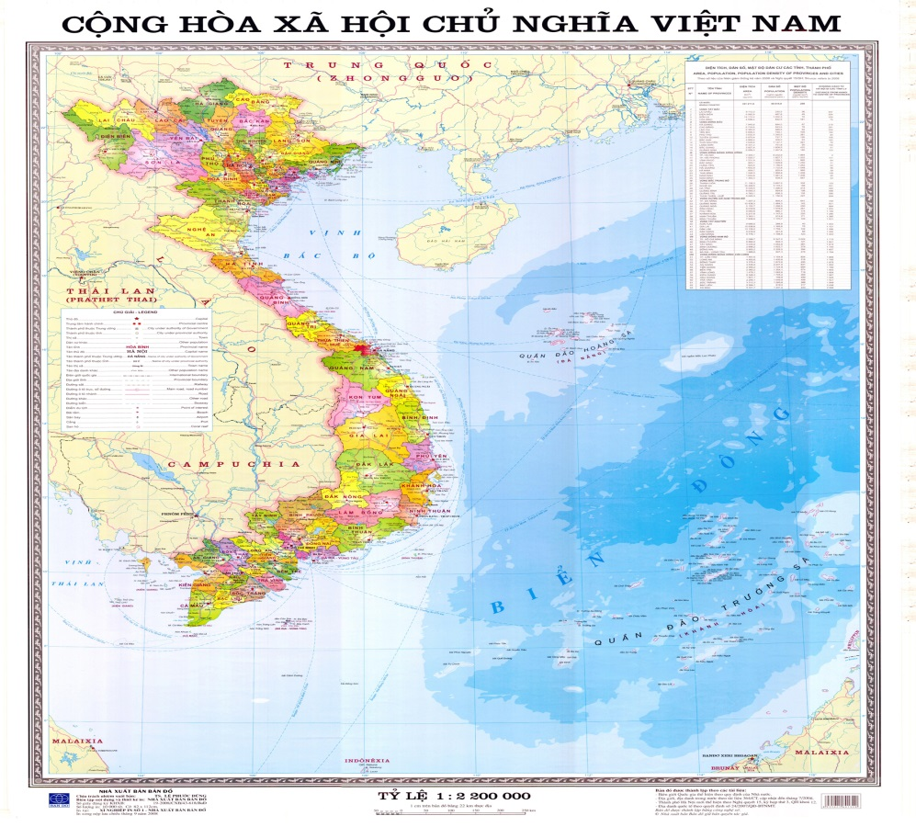
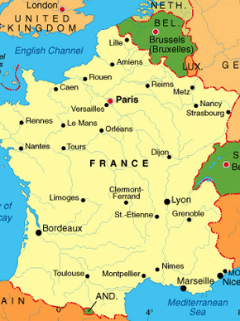
Acreage
VIETNAM
FRANCE
331.210 km²
643.801 km²

Slide 5


Population
VIETNAM
FRANCE
95,54 milion (2017)
59.797 milion (2017)

